Slide 1
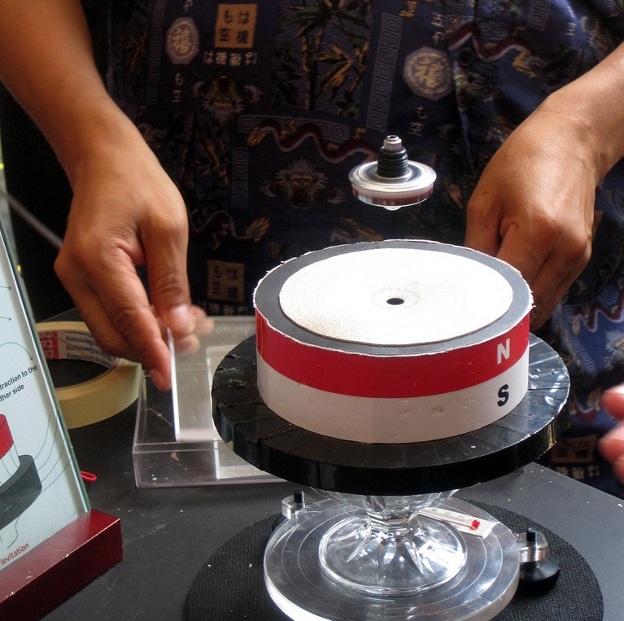
Lecture 7 – Precession of Angular Momentum, Torque and Rotation with translation
Notes:
Earnshaw theorem

Slide 2

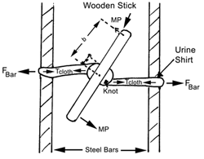
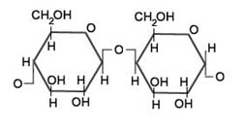
Jackie Chan and Torque

Slide 3
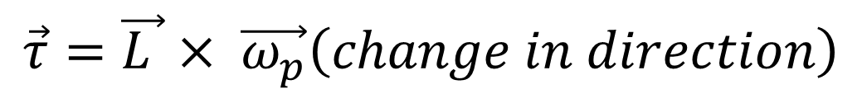
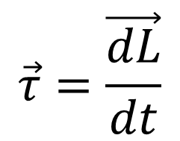
Recap of Last Lecture
1. Magnitude and direction of angular momentum changes in the direction of torque
$$\vec{τ}=\frac{\vec{dL}}{dt}$$
2. Angular Momentum vector precess under the influence of torque and the precession frequency is denoted by ω_{p}
$$\vec{τ}=\vec{L }× \vec{ω_{p}}\left(change in direction\right)$$

Slide 4
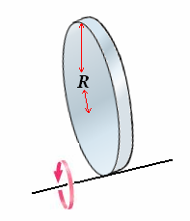
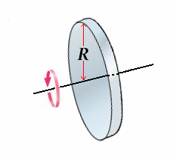
Moment of Inertia and Parallel axis theorem
Moment of inertia = MR²/2
Moment of inertia = 3MR²/2

Slide 5
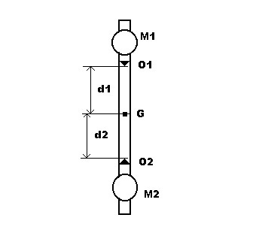
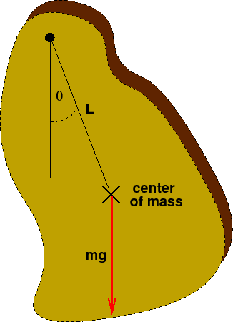
Moment of Inertia of non-uniformly distributed mass
Notes:
Video of wobbling fan and car inertial measurement system

Slide 6
Physical Pendulum
Lets first find the moment of inertia for this pendulum
I = I ₀+ I’
Where
I₀ is the moment of inertia about an axis passing through CM
I’ is the moment of inertia of the point mass located at CM
Notes:
Radius of gyration of a substance gives you the radius of a ring which has the same moment of inertia as the body. It is simply the square root of the coefficient of M(mass) in the formula of the moment of inertia. Moment of inertia of a rod is mlsq/12. Radius of gyration is square root of mlsquare/12. Point mass here represent the fact that the entire mass is supposed to be concentrated at this point.

Slide 7
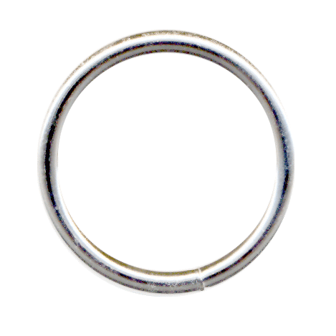
Physical Pendulum
I₀ is the moment of inertia about an axis passing through CM
Radius = k
Mass = m
Moment of Inertia I₀ = mk²
Notes:
When the dimensions of the suspended body are not negligible compared to the distance from the
suspension axis to the center of mass, the pendulum is called a physical pendulum. Any object
mounted on a horizontal axis so as to oscillate under the force of gravity is a physical pendulum. Radius of gyration tell us how the mass is distributed across an irregular object.

Slide 8

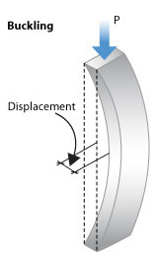

Radius of Gyration
Notes:
The (smallest) moment of inertia I of this section is about 120 000 cm⁴, area A is 953.2 cm² and its radius of gyration r is thus of the order 11 cms. Radius of gyration is square of root of moment of inertia over area.

Slide 9
Physical Pendulum
The only force that provides torque to this system is gravity
Force along the line joining the axis of rotation and center of mass = mg cosθ
Force perpendicular to the line joining the axis of rotation and center of mass = mg sinθ
θ

Slide 10
Physical Pendulum
θ

Slide 11

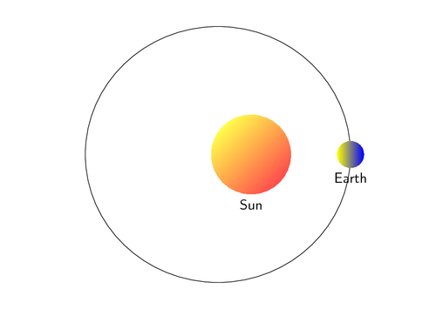
Angular Momentum of Body Both Rotating and Translating
In most practical situations we come across objeccts which both rotates and translates.
For instance
Tightening of a Screw
Earth – sun system

Slide 12
Rotation and Translation
z'
z
r'
r
Center of mass
R
y'
y
x'
x
Angular momentum in Lab frame

Slide 13
Rotation and Translation

Slide 14
Rotation and Translation
Angular momentum due to the translation of center of mass with respect to lab frame

Slide 15
Rotation and Translation
Origin of r_{j}’ is the center of mass
The particle rotate about center of mass without changing its magnitude.
Angular momentum due to rotation about the center of mass
Notes:
When a rigid body rotates about an axis every particle in the body remains at a fixed distance from the axis. If we choose this axis to be the origin for our coordinate system then distance r remains constant. Only way for r to change in this scenario is to change its direction which can be achieved if velocity is perpendicular to r.

Slide 16
Rotation and Translation
Statement:
Angular momentum of a rigid body is the sum of angular momentum of the center of mass about the origin and angular momentum about its center of mass

Slide 17
Example – Angular Momentum of a Rolling Wheel
y
ω
R
V
b
x
Angular Momentum about the Center of Mass

Slide 18
Example – Angular Momentum of a Rolling Wheel
y
ω
R
V
θ
b
x
Angular Momentum of the Center of Mass

Slide 19
Example – Angular Momentum of a Rolling Wheel
y
ω
R
V
θ
b
x
Total Angular Momentum of the Wheel about origin

Slide 20
Summary
Angular momentum of a rigid body is the sum of angular momentum of the center of mass about the origin and angular momentum about its center of mass
What about TORQUE? Does it follow the same rule?

